Slide 1


Deep Learning + Dojo
Learning deeply Agile & DevOps
Notes:
https://pixabay.com/en/man-reading-touchscreen-blog-791049/#_=_

Slide 2


About me
Leonardo Souza Mattos
IT Principal Consultant - SAP
Notes:
https://pixabay.com/en/write-plan-business-startup-593333/

Slide 3
Agenda
Introduction of the problem
Deep learning
Ignition for change
Driving an organization transformation involves changing old habits
What is deep learning and how that can help me?
Challenging situations motivates us
Coaching on developing new skills
Dojo
Conclusion
Impact of deep learning and how to model one with those concepts in mind
What is next?
Role of the coach on the deep learning process

Slide 4
Introduction of the problem
We have seeing in many places, as part of transformation efforts, coaches and changes agents having hard time on changing old habits and teaching new skills on all levels of organization. We have seem intents using well structured workshops, classroom trainings, guided exercises and some executive coaching, as few examples of techniques, being applied very thoughtfully, where new skills or desired behaviors, with very convincing arguments, are presented, understood and soon all forgotten, if applied some day.
Lean and Agile practices involves change of habits
From books and classrooms we memorize things and don’t know how to apply them later
Humans are motivated to change when they see results of the new
“You will become clever through your mistakes” – German proverb

Slide 5

Why is so difficult to change behavior ?
Or having a lasting learning experience?

Slide 6
8 reasons why
We’re motivated by negative emotions.
We get trapped by thinking fallacies
We try to
eat the
entire elephant
We neglect the toolbox
We try to change too much ( at the same time )
We under
estimate the process
We forget that failure is usually a given
We don’t make a commitment
Notes:
1. We’re motivated by negative emotions. While it’s understandable to think that strongly felt negative emotions like regret, shame, fear, and guiltshould be able to catalyze lasting behavior change, the opposite is true. Negative emotion may trigger us to think about everything we’re not doing, or feel like we’re doing wrong, but it’s horrible fuel for making changes that stick. One review of 129 behavior change studies found that the consistently least effective change strategies hinged on fear and regret. As much as this sounds like a platitude, real change needs a positive platform to launch from; you need positive, self-edifying reasons for taking on the challenge.
2. We get trapped by thinking fallacies. Feeling overwhelmed by trying to change a behavior tends to foster all-or-nothing thinking: "I'm going to charge in and change, and if I fail, that means I just can't do it." If you’re up on your cognitive biases and distortions, you know that all-or-nothing thinking is a major one. It traps us into no-win situations, because your odds of sustaining even the most impressive jolt of momentum to change a behavior just aren’t very good. (Think of gym memberships exploding in January and petering out by March.) If we really want to change, one of the first things we have to do is take all-or-nothing off the table, and purge a few other thinking errors while we’re at it.
3. We try to eat the entire elephant. Behavior change is a big thing, no matter the behavior, and it’s almost never possible to take all of it on at once. We have to start somewhere, though, and with particular, measurable actions. Big and vague has to give way to small and specific. Rather than, “I’m going to start exercising,” it’s, “I’m going to start walking tonight after work for 30 minutes down Edgemont Road.” Each specific action is one forkful of behavior change, and a set of those actions engaged over time results in cumulative change. To accompany those cumulative actions, we need specific goals, which behavior change research suggests are essential to success, because we need performance targets to measure ourselves against. But those, too, should be realistic and specific.
4. We neglect the toolbox. If you want to fix your car, you need the right tools. Why should changing something about ourselves be any different? Call them tools or devices or whatever you like; the point is that we need certain reliable go-tos to support sustained change. Changing our diet requires, at minimum, that we find the knowledge about healthier ways to eat and a practical plan for making it happen. Maybe part of the plan includes keeping a crib sheet menu in the notepad on your phone, or daily reminders built into your Outlook calendar. Some of these tools will be specific to an individual, while others are widely adopted and available to anyone who needs them. We all need a toolbox of such supports to rely on during the long haul.
5. We try to change too much. If you can commit to changing one behavior long-term, and really make it stick, that’s commendable. But trying to take on multiple behaviors at once is a surefire way to send all of them into a ditch. The resources we rely on to make change happen are limited — attention, self-control, motivation, etc. Trying to change too much places unrealistic demands on those resources and dooms our efforts early on. We forget that the other areas of our lives keep spinning and also require those resources, so even just one additional behavior-change commitment is a big deal.
6. We underestimate the process. Change is never just one thing; it’s a lot of connected things, and sustained change doesn’t happen without a process that considers all of the pieces. You can consult any number of models for behavior change (such as the TTM Model), and spending some time doing that is worthwhile, but the bigger point is that long-term behavior change involves steps. It’s easy to fool ourselves into believing that it should be so much simpler, but nothing about behavior change is simple. It’s a tough, process-oriented challenge to move the needle even a little. 7. We forget that failure is usually a given. If you try to make a change and fail, you’ve proven one of the sturdiest truths of behavior change: Failing at least once is part of the process, and it’s probably going to be more than once. Failing reveals more to you about what deserves your attention and energy in the next round (and the next). The time-tested change process models all factor in failure as part of the process, and encourage those who would change to see failing as a step, not as the end of the process or an excuse to stop trying.
8. We don't make a commitment. Finally, but perhaps most important, what the best of behavior change research tells us is that if we haven't made a commitment to accomplish whatever we want to accomplish, it won't happen. We need a "commitment device" that firmly establishes what we're going to do and how we're going to do it. Everything else starts there.

Slide 7
What is deep learning ?
Work-Based
Learning
“Deeper learning is the process of learning for transfer, meaning it allows a student to take what’s learned in one situation and apply it to another.”
– Maryellen Weimer, PhD
Project-Based Learning
Inquiry-Based Learning
Connected Learning
Performance Assessments
Notes:
Blablabla
In a project-based learning (PBL) environment, students develop knowledge and skills while investigating a meaningful problem or answering a complex question. Typically, projects feature real-world context, incorporate standards-based tasks and tools, and tap students’ interests. Students share their project/work publicly by explaining, displaying, and/or presenting it to classmates and others.
In a work-based learning environment, students apply classroom content and knowledge in real-world settings through a clear connection between school and work. Strong relationships between schools and local employers support this approach. Schools provide students with rigorous academic instruction and content preparation, while employers offer off-site job placements that allows students to participate in authentic work experiences and develop habits and skills, such as critical thinking, problem-solving, and collaboration.
In an inquiry-based learning environment, students are the engines of their own learning and seek knowledge by asking questions. The resolutions to the questions, issues raised, and development of a process of inquiry are more important than correct answers.
The teacher works with students to establish a process and framework for asking questions and developing knowledge. As the leader and facilitator, the teacher models the process to enable students to see inquiry in action and learn its steps.
Connected learning uses digital media to engage students’ interests and results in deeper learning outcomes, such as communication, collaboration, and critical thinking. The connected learning model posits that focusing educational attention on links between different spheres of learning—peer culture, interests, and academic subjects—better supports interest-driven and meaningful learning in ways that leverage the potential of digital networks and online resources to provide access to an engaging learning experience.

Slide 8
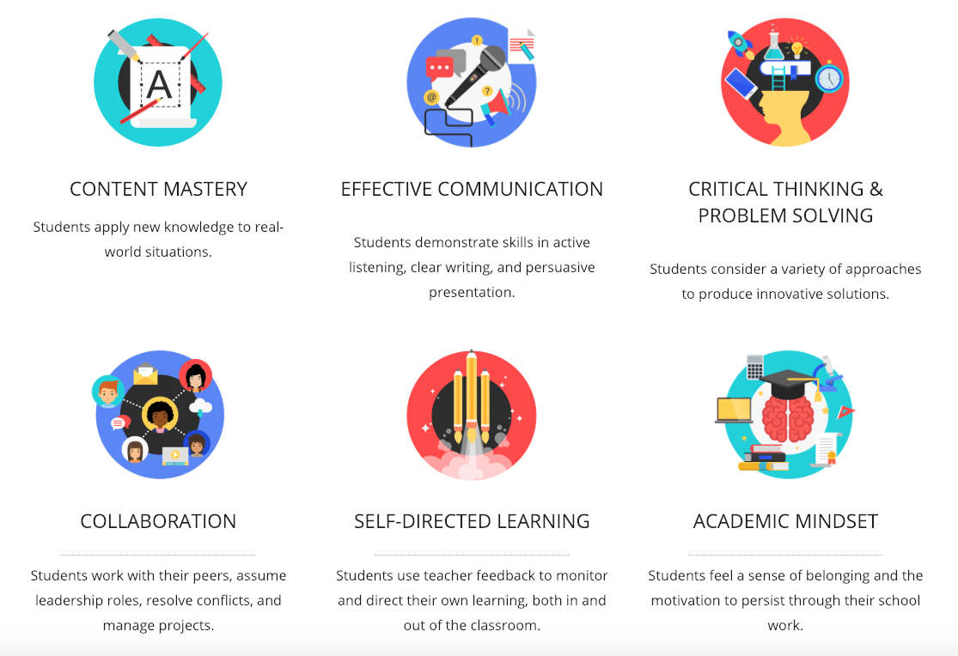
And how that can help me?

Slide 9

Deep practice and skill building
“I have always maintained that excepting fools, men did not differ much in intellect, only in zeal and hard work.”
– Charles Darwin
Deep practice is a strange concept for two reasons:
The first reason is that it cuts against our intuition about talent.
The second reason deep practice is a strange concept is that it takes events that we normally strive to avoid—namely, mistakes—and turns them into skills. To understand how deep practice works, then, it's first useful to consider the unexpected but crucial importance of errors to the learning process.
Notes:
Deep practice is built on a paradox: struggling in certain targeted ways—operating at the edges of your ability, where you make mistakes—makes you smarter. Or to put it a slightly different way, experiences where you're forced to slow down, make errors, and correct them—as you would if you were walking up an ice-covered hill, slipping and stumbling as you go—end up making you swift and graceful without your real- izing it.
The reason, Bjork explained, resides in the way our brains are built. "We tend to think of our memory as a tape recorder, but that's wrong," he said. "It's a living structure, a scaffold of nearly infinite size. The more we generate impulses, en- countering and overcoming difficulties, the more scaffolding we build. The more scaffolding we build, the faster we learn."
When you're practicing deeply, the world's usual rules are suspended. You use time more efficiently. Your small efforts produce big, lasting results. You have positioned yourself at a place of leverage where you can capture failure and turn it into skill. The trick is to choose a goal just beyond your pres- ent abilities; to target the struggle. Thrashing blindly doesn't help. Reaching does.
Deep practice is a strange concept for two reasons. The first reason is that it cuts against our intuition about talent. Our intuition tells us that practice relates to talent in the same way that a whetstone relates to a knife: it's vital but useless without a solid blade of so-called natural ability. Deep prac- tice raises an intriguing possibility: that practice might be the way to forge the blade itself.
* Good advertising operates by the same principles of deep practice, increasing learning by placing viewers in the sweet spot at the edge of their capabilities. This is why many successful ads involve some degree of cognitive work, such as the whiskey ad that fea- tured the tag line "... ingle ells, ... ingle ells ... The holidays aren't the same without J&B."
The Sweet Spot 1 9
20The Talent Code
The second reason deep practice is a strange concept is that it takes events that we normally strive to avoid—namely, mistakes—and turns them into skills. To understand how deep practice works, then, it's first useful to consider the unexpected but crucial importance of errors to the learning process. In fact, let's consider an extreme example, which arrives in the form of a question: how do you get good at something when making a mistake has a decent chance of killing you?

Slide 10
Three rules of deep practicing
03
Learn to feel it
We need to fill the “muscle burning’ effect of the learining, on the right amount of struggle. That feeling that reminds your around the effort to develop the new skill and that you need to keep practicing to fill the gap, everytime smaller, between your current state and the target one.
We're all familiar with the adage that practice is the best teacher. There is, biologically speaking, no substitute for attentive repetition. Nothing you can do—talking, thinking, reading, imagining—is more effective in building skill than executing the action, firing the impulse down the nerve fiber, fixing errors, honing the circuit.
Chunking takes place in three dimensions. First, the participants look at the task as a whole—as one big chunk, the megacircuit. Second, they divide it into its smallest possible chunks. Third, they play with time, slowing the action down, then speeding it up, to learn its inner architecture.
02
Repeat it
01
Chunk it up
“Try again. Fail again. Fail better” - Samuel Becket

Slide 11
Ignition for change
hhhhhh
Dates don’t account for non-project related work that inevitably creeps into our days : emails, meetings, and interviews that a team member may be involved in
Where deep practice is a cool, conscious act, ignition is a hot, mysterious burst, an awakening. Where deep practice is an incremental wrapping, ignition works through lightning flashes of image and emotion, evolution- built neural programs that tap into the mind's vast reserves of energy and attention; the moments that lead us to say that is who I want to be.
It will boost the skill development with external stimulus. The response to it you can call it “fascination, rapture or love”, that instantly connect us to a high-octane fuel tank of motivation
What ignites the accelerated progress is a vision of your ideal future selves, a vision that oriented, energized, and accelerated progress, and that originates in the outside world
Skill is insulation that wraps neural circuits and grows according to certain signals. And the best to trigger them are primal cues.

Slide 12

The language of ignition
When we use the term motivational language, we are generally referring to language that speaks of hopes, dreams, and affirmations ("You are the best!"). This kind of language— let's call it high motivation—has its role.
But high motivation is not the kind of language that ignites people. What works is precisely the opposite: not reaching up but reaching down, speaking to the ground-level effort, affirming the struggle.
Notes:
Thus far we've learned a few things about the nature of our ignition switch. First, it's either on or off. Second, it can be triggered by certain signals, or primal cues. Now we'll look more deeply into how it can be triggered by the signals we use most: words.

Slide 13
Coaching for new skills
What does a story point represent?
How do we plan/schedule a project using story points?
What is included within a story point estimate?
Can story points be standardized across teams?
Are story points an excuse for not being able to estimate correctly?
How do we know if a team is getting better at estimation?
Who should be involved in story point estimation?
Why are story points better than estimating in hours or days?

Slide 14
Dojo + Deep Practice
This is a iterative process you must do during your PBRs ( my preference ) or as part of estimation meeting, for all stories marked as “ready” on your backlog.
Always estimate stories against each other. We thus need a frame of reference, to relatively size stories
Define the buckets you will have. My suggestion to have at most 4 buckets.
Relatively size each story against benchmark story by discussing only the implementation details that affect its size
Place each story into a bucket
At the end, for each story bucket, do a quick review of the stories in them. Validate they are all reasonably close in “size” to each other.
Notes:
On first point, if you have already some medium size stories, then use them. If not, select the one you think its medium size and use as reference to compare.
I always prefer to use just 3 scaled , that can be 2, 4 and 8. That is because I think that thinking inn term of numbers like ( double, half, triple is easier than compare t shirt sizes. )
At the last steps, its optional and needs to be done in group. You can shift the bucket if required.

Slide 15
Dojo structure
Problem : When we estimate relatively in size, we get different developers would complete the same 2 size story in different speeds.
The theory says that if we calculate the velocity based on speed that each team member completes the same size story, then this deviation on speed will not matter, when we define a scope for a fix period of time
Notes:
Many teams find that estimation provides a useful forcing function to get team members to talk to each other. Estimation meetings or PBRs, can help get better understanding of various ways to implement upcoming stories, future architectural directions, and design problems in the code base.
About the “stop doing” side effect, the rational is that part of the decisions to do an estimation is to predict when some item or feature will be done. So, when the teams mature on the estimating skills, usually is result on better and size standardized stories, which might drive to on spot estimation just for some specific decision driven by this info, and not predictability or previsibility of delivery.

Slide 16
Expected results
This calculation is considering the bucket theory and the concept of individual speeds over a fix period of time.

Slide 17
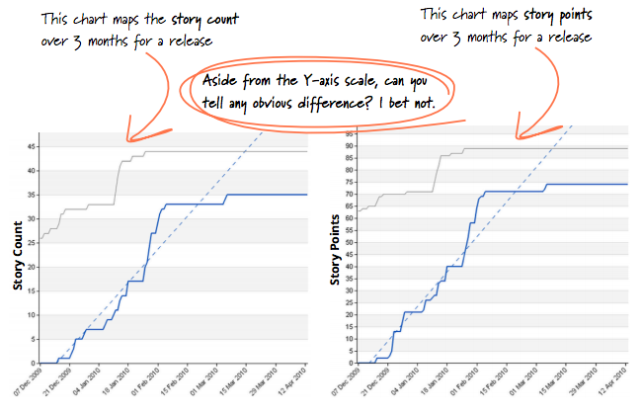
Now its your time
Introduced by Thoughtworks consulting company after experience in tens of projects with clients
Over time, when doing the distribution in groups ( like buckets ) by points, they saw that most og the stories were getting into the same bucket
Comparing the burn up graphs based on story points or number of cards, they started to look all the same, independent of the size of the cards after a span of 2 weeks.
Still keep the estimations sessions. There are still high value on team conversation catalyzed by gauging the size of the work
Changed to follow progress using story count on burn up
Still use estimated points as reference for priorization
Notes:
Benefits :
Fewer metrics, more conversations – in estimation meetings, we have shifted focus from numbers to a collaborative conversation. This provides a better platform for our team to discuss and eventually establish a shared understanding about what to build and how. We noticed that subsequent development work became much smoother after these conversations.
Less math, more effective planning – in scope planning meetings where we used points, we had to scratch our heads to figure the exact number of points to put in ot take out. Freed up from these calculations, we focus more on business value and being more responsive to ad-hoc requirements.

Slide 18
In summary
Understand that each team’s approach to estimation evolves as the product progresses or team matures
Explore different ways to estimate and pick one that suits your team/product
blablsa the purpose of estimation
In agile model, the estimation is not to track progress against a plan. Its to help define scope of a release
As important as the estimation is the conversation and understanding it generates
Understand velocity is as important as understand the size of the story

Slide 19
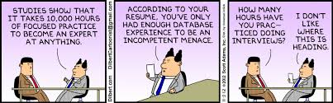
Thank you!!
“ So whenever you’re thinking of asking for an estimate, you should always clarify what decision that estimate is informing. If you can’t find one, or the decision isn’t very significant, then that’s a signal that an estimate is wasteful. “
Martin Fowler

